Slide 1

CIF FY17 Business Plan and Budget
Mafalda Duarte
June 15, 2016

Slide 2
Overview
1. CIF Portfolio trends
2. Looking back – achievements of FY16
3. Looking forward – action priorities for FY17
4. Summary of proposed FY17 budget
  Administrative Services
  Support for Country Programming
  Knowledge and Learning
  Special Initiatives

Slide 3
CIF Portfolio Trends (1/3)
62 investment plans (IPs) endorsed (including regional programs)
3 IPs will be reviewed in this committee meeting
20 IPs will be submitted for endorsement in FY17
  2.5 times more than the annual average of 8 IPs.
  All IPs prepared over FY17 and FY18 will be subject to a preliminary expert review
Summary of CIF Investment Plan Submissions

Slide 4
CIF Portfolio Trends (2/3)
CIF Portfolio Approvals Overview
49 projects, with USD 1.1 billion (est.) to be approved in FY16. As of May 31, 2016, 31 projects with USD 980 million were approved.
Cumulative approvals at the end of FY16 would be USD 6.7 billion. This figure is projected to increase to USD 8.1 billion by the end of FY17.
* Actual as at May 31, 2016 and projections to June 30, 2017

Slide 5
CIF Portfolio Trends (3/3)
CIF Approval Trends – Inception to FY17
* FY 16 estimates are as of May 31, 2016

Slide 6


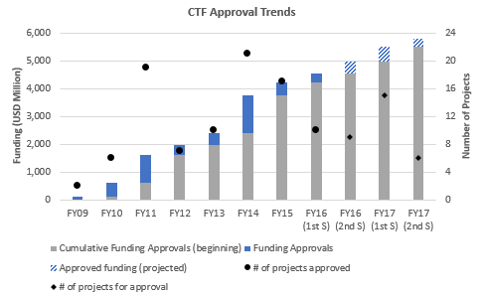
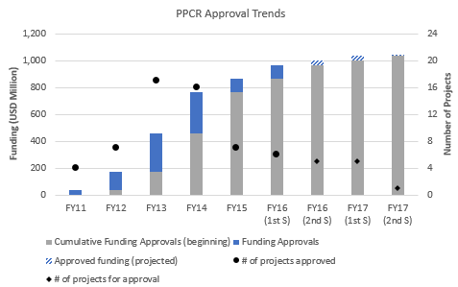


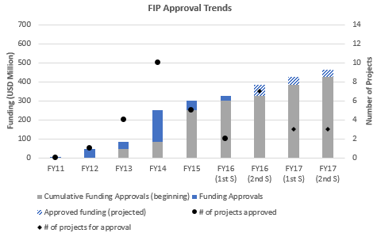
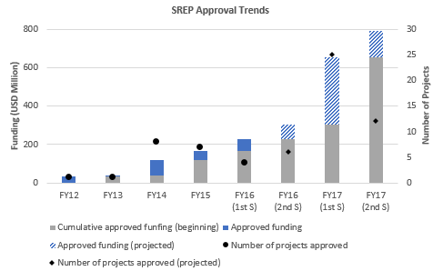
CIF Program-by-Program Approval Trends

Slide 7




Looking Back – Achievements of FY 16
Intensive engagement in new CIF countries
  USD 17.4 million approved in IP Preparation Grants to 24 countries of 25 new CIF countries
  40 scoping, joint, and technical missions undertaken
  Expansive stakeholder engagement, applying lessons learnt from first cohort of pilot countries
Strategic analysis of the CIF
  Gap analysis completed
  CTF financing modalities explored
  New frontiers for PPCR, FIP, and SREP explored
  Strategic staffing to boost technical skills in the CIF continued
Technology and innovation in the CIF
  Online open source data platform (SOCRATA) for results reporting
  FIF collaborative platform further developed – comments tracking application completed
  Enterprise Risk Management (ERM) risk dashboards operationalized

Slide 8

Looking Forward –Action priorities for FY17
Continue strategic analysis based on decisions and recommendations of the Joint TFC and SCF Committee
Complete strategic staffing with 5 additional positions proposed
Redefining risk management to provide timely, relevant, and critical risk-related information
Enhance financial management practices
Deepen the gender approach: launch of the Phase 2 Gender Action Plan
Enhance the generation and sharing of knowledge and learning to increase the quality, scope, and reach of evidence-based knowledge, results, and learning
Enhance results monitoring and broaden stakeholder engagement
More focused private sector engagement

Slide 9

Summary of Proposed FY17 Budget (1/2)
Proposed budget FY17: USD 23.8 million
Summary of budget drivers:
  Proposed increase in staffing cost, as main driver for increase in administrative services
  Zero request for country programming in FY 17
  Implementation of multi-year activities approved in FY16 as special initiatives will continue in FY17:
    Operationalization of the Evaluation and Learning Advisory Group Business Plan
    Year 2 implementation of the Multi-Tier Access Framework to Support Investment Planning in SREP
    Second phase of the Enterprise Risk Management Dashboard
    Continuation of the CIF strategic analysis

Slide 10
Administrative Services (1/2)
Distribution of administrative services*
(*administrative services represent the services provided by the CIF Administrative Unit, focal point teams of the MDBs and trustee to deliver on the mandate of the CIF)

Slide 11
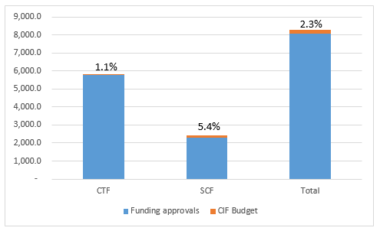
Administrative Services (2/2)
CIF cumulative budget from FY09 – FY17 is about 2.3 % of funding approvals for projects and programs.
In FY17, the ratio of budgetary costs to approved funding is expected to be 2.4 %.
CIF cumulative budget as a
% of project funding (FY09-FY17)

Slide 12
Knowledge and Learning
USD 1.4 million is needed for Learning and Knowledge Exchange activities to fund the following:
Two pilot country meetings (CTF/SREP and PPCR)
Two knowledge and learning studies on mini-grid and energy efficiency
Two events at the World Bank Group Annual Meetings in Washington, DC and COP22 in Morocco
USD 960,000
USD 325,000
USD 100,000

Slide 13
MDB Support for Country Programming
Considering the balance of funds available to support country programming in FY17, no additional “top-up” of this multi-year budget is requested.
Balance of funds as of June 30, 2016
USD 8.2 million
 | CTF | SCF | Total
Total budget approved in Business Plan (FY09-FY16)* | 5.8 | 34.6 | 39.9
Estimated balance on 6/30/2016 (allocations + returned funds) | 1.9 | 6.3 | 8.2
Estimated requests in FY17 | 0.2 | 6.3 | 6.5
Balance of multi-year country programming budget for FY18 | 1.7 | 0 | 1.7
FY 17 estimated requests
USD 6.5 million
Estimated balance of
Country Programming Budget
USD 1.7 million
*Including supplemental budget approved in August, 2015
(All amounts in USD’000)

Slide 14

Special Initiatives
USD 1.9 million is requested in FY17 for the following special initiatives:
CIF strategic analysis (USD 1 million)
Support to GHG analysis and harmonization of methodology (USD 100,000)
Collaboration with the PROFOR team (USD 112,000)
Phase II of the Enterprise Risk Management implementation (USD 180,000)
Second year implementation of the multi-tier access framework (USD 500,000)

Slide 15




Mafalda Duarte
Mduarte@worldbank.org
(202) 473 - 4678
www.climateinvestmentfunds.org
@CIF_Action
https://www.youtube.com/user/CIFaction
https://www.flickr.com/photos/cifaction/sets

