Slide 1
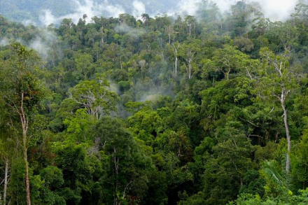
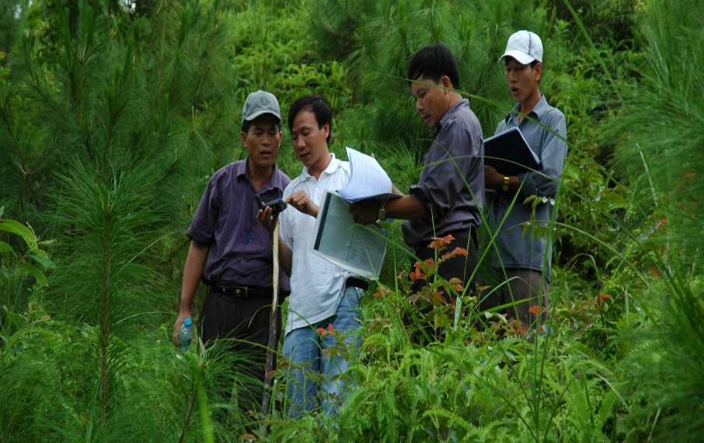
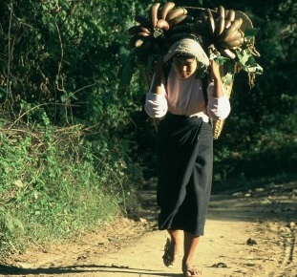
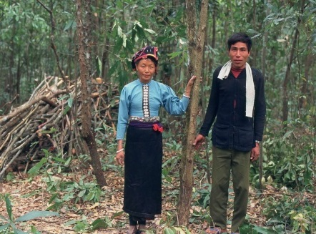
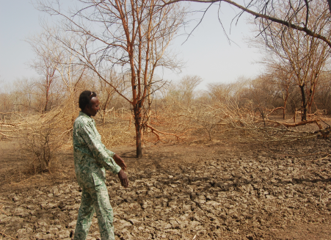
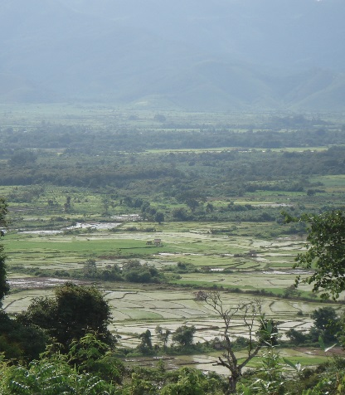
Report from Joint Meeting on Strategic Directions of the CIF
^{DATE June 12-14, 2016}
^{PLACE Oaxaca, Mexico}

Slide 2
Outcomes from the Joint Meeting
Excerpts from the decision of the joint meeting on the strategic directions for the CIF:
Notes that the analysis took into account future opportunities and explored roles each CIF program could play based on its comparative advantage and value added.
Notes the need to support the continuity of climate finance flows at scale in the near term through a diverse set of finance options
Recognizes the important role of the MDBs delivering climate finance
Highlights the importance of disbursing current CIF funds effectively
Agrees to continue monitoring the developments in the international climate finance architecture to inform the discussion on the sunset clause in Dec 2018 at the earliest, and take decision on this issue in June 2019, in particular as to if and when the Trustee should stop receiving new contributions for the CTF and/or the SCF.

Slide 3
Outcomes from the Joint Meeting
Excerpts from the decision of the joint meeting on the strategic directions for the CIF:
Agrees to enhance cooperation between CIF and other entities, particularly GCF through
Improved coordination at country level led by CIF Focal Points and GCF NDAs, including cooperation with MDBs as requested
Enhanced efforts by all CIF stakeholders to share lessons learned, including through CIF’s evaluation and learning special initiative
Explore joint training and learning for CIF and other multilateral climate finance mechanisms
Invites SCF Sub-Committees to consider the analysis presented the Strategic Directions paper on the specific context, lessons learned, and continued value proposition of these three programs (FIP, SREP and PPCR).

Slide 4
Lessons Learned From FIP
Forests have unfulfilled climate and development opportunities
Forests essential to Paris Agreement and SDG achievement
Governments and MDBs face challenges in prioritizing the forest sector for large scale investment
Almost half of FIP investments are for capacity building efforts necessary for sector development
The FIP programmatic approach brings together multi-stakeholder groups that fosters country-driven, integrated sectoral approach often facilitating an overdue strategic dialogue
DGM is unique model for engaging with and empowering forest-dependent indigenous peoples and local communities
Engaging the private sector requires more flexible approach

Slide 5
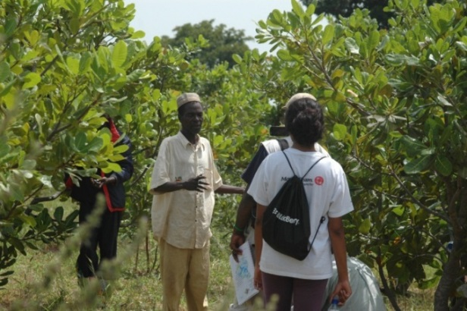
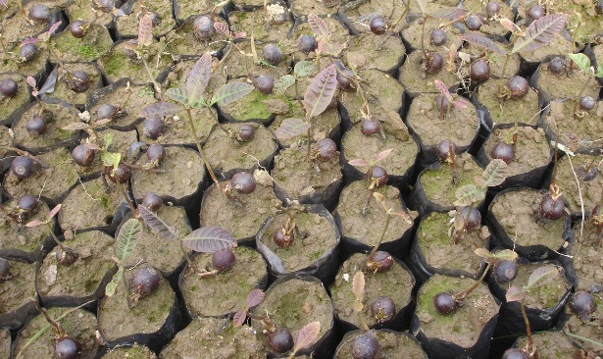
FIP: Value proposition going forward
Growing portfolio of programs/projects generating valuable lessons
Experience from a wide range of forest types and situations
Partnership with MDBs – ability to integrate forests into wider climate-smart land use.
DGM is a model for engaging with and empowering forest-dependent indigenous peoples.
Convening power to lead dialogue on the role of forests in achieving INDCs and development targets.

Slide 6
FIP: Future scenarios
Scenario 1: No new funds are provided
Risk that forests are not effectively incorporated into INDC implementation plans in new FIP countries
Scenario 2: New funds are provided
Extend implementation funding to some [all] of the 9 “unfunded” pilot countries
Expand DGM to the 9 pilot countries
Capitalize new FIP private sector window
Support global forest challenges through “horizontal” strategic thematic programs
Implementation Model for a Strategic Thematic Program
Cross-country Strategic Program
Cross-country Strategic Program
Country B IP
Country A IP
Country C IP

Slide 7
Mafalda Duarte
Mduarte@worldbank.org
(202) 473 - 4678
www.climateinvestmentfunds.org
@CIF_Action https://www.youtube.com/user/CIFaction https://www.flickr.com/photos/cifaction/sets

